Slide 1
Unit 5 Series Circuits
Part D: Voltage Measurement with respect to Circuit Ground

Slide 2
What will you learn?
The differences between voltage across a component and voltage at a node w.r.t. a reference ground.
Apply node voltage and reference ground for circuit analysis.
Advantages of using node voltage and reference ground.

Slide 3
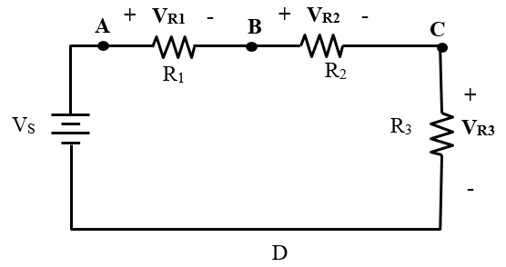
Measure Voltage across Components
To measure voltage drops across resistors R₁, R₂ and R₃, connect a voltmeter in turn as shown below.
V_{R2}
V_{R3}
V_{R1}

Slide 4
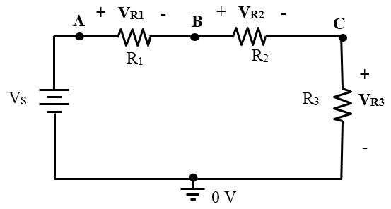



Measure Note Voltage w.r.t. Ground
V_{A} = the voltage at node A with respect to the ground.
V_{B} = the voltage at node B with respect to the ground.
V_{C} = the voltage at node C w.r.t. the ground.
Voltage difference across a component can be calculated from node voltages.
$V_{R1}=V_{AB}=V_{A}−V_{B}$
V_{C}
V_{B}
V_{A}
$V_{R2}=V_{BC}=V_{B}−V_{C}$
$V_{R3}=V_{C}$

Slide 5






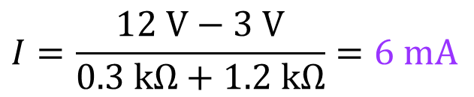

Example 1: (a) Determine or calculate V_{D} , V_{A}, V_{C}, and the circuit current I. (b) calculate V_{R1}, V_{R2} and V_{B}.
$$\left(a\right) ∵D is the reference ground.∴V_{D}=0 V$$
$V_{1}$
_
$V_{2}$
_
+
+
The 12 V supply provides a voltage rise of 12 V from its −ve terminal to its +ve terminal.
A
C
$$R_{1}$$
B
$$R_{2}$$
+
_
300 Ω
1.2 kΩ
+
_
12 V
3 V
$$∴V_{A}=12 V$$
The 3 V supply provides a voltage rise of 3 V from its −ve terminal to its +ve terminal.
D
∵ 12 V > 3 V, ∴ the circuit current flows out from the +ve terminal of the 12 V supply and returns to its −ve terminal.
$$∴V_{C}=3 V$$
$$I=\frac{12 V−3 V}{0.3 kΩ+1.2 kΩ}=6 mA$$

Slide 6











Example 1: (a) Determine or calculate V_{D} , V_{A}, V_{C}, and the circuit current I. (b) calculate V_{R1}, V_{R2} and V_{B}.
$${\left(b\right) V}_{R1}=IR_{1}=6 mA×0.3 kΩ=1.8 V$$
$V_{1}$
_
$V_{2}$
_
+
+
$$V_{R2}=IR_{2}=6 mA×1.2 kΩ=7.2 V$$
A
C
$$R_{1}$$
B
$$R_{2}$$
∵ From A to B, a voltage drop of 1.8 V
+
_
+
_
300 Ω
1.2 kΩ
$$∴V_{B}=V_{A}−1.8 V$$
12 V
3 V
$$=12 V −1.8 V$$
$$=10.2 V$$
D
Another way:
∵ From C to B, a voltage rise of 7.2 V
$$∴V_{B}=V_{C}+7.2 V$$
$$=3 V −7.2 V$$
$$=10.2 V$$

Slide 7
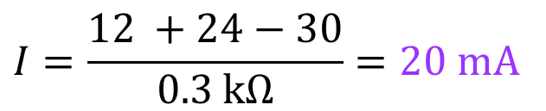


Example 2: (a) Calculate the total resistance and the circuit current. (b) Calculate the voltages drops across the resistors and the voltages at nodes A to E.
A
B
$${\left(a\right) R}_{T}=100+200=300 Ω$$
$$R_{1}$$
30 V
100 Ω
24 V
$$I=\frac{12 +24−30}{0.3 kΩ}=20 mA$$
C
$$R_{2}$$
The 20 mA circuit current flows counter-clockwise.
12 V
200 Ω
E
D
$${\left(b\right) V}_{R1}=IR_{1}=20 mA×0.1 kΩ=2 V$$
$$V_{R2}=IR_{2}=20 mA×0.2 kΩ=4 V$$

Slide 8





Example 2: (a) Calculate the total resistance and the circuit current. (b) Calculate the voltage drops across the resistors and the voltages at nodes A to E.
A
B
$$∵E is the reference ground.∴V_{E}=0 V$$
$$R_{1}$$
30 V
100 Ω
24 V
$$∵V_{E}=0 V and the 12 V voltage source$$
C
$$∴V_{D}=12 V$$
$$R_{2}$$
12 V
200 Ω
∵ Current flows counter-clockwise.
∴ A voltage drop occurs from D to C
E
D
$$V_{R2}=IR_{2}=20 mA×0.2 kΩ=4 V$$
$$V_{C}=V_{D}−4 V$$
$$=12 V −4 V$$
$$=8 V$$
$$∵V_{E}=0 V and the 12 V voltage source$$
$${∴V}_{D}=12 V$$

Slide 9


Example 2: (a) Calculate the total resistance and the circuit current. (b) Calculate the voltages drops across the resistors and the voltages at nodes A to E.
A
B
$$∵V_{C}=8 V and the 24 V voltage source$$
$$R_{1}$$
30 V
100 Ω
24 V
$${∴V}_{B} =8+24=32 V$$
C
$$∵V_{E}=0 V and the 30 V voltage source$$
$$R_{2}$$
12 V
200 Ω
$$∴V_{A}=30 V$$
E
D

Slide 10




















Effects of Changing Reference Ground
No change in: circuit current and voltage difference across a component.
All node voltages change.
$V_{R1}=2 V$
$V_{R1}=2 V$
$$V_{A}=30 V$$
_
$$V_{B}=32 V$$
$$V_{A}=18 V$$
_
$$V_{B}=20 V$$
+
+
$$R_{1}$$
$$R_{1}$$
30 V
100 Ω
24 V
30 V
100 Ω
24 V
$$V_{C}=8 V$$
$$V_{C}=−4 V$$
_
_
$$I=20 mA$$
$$R_{2}$$
$$I=20 mA$$
$$R_{2}$$
$V_{R2}=4 V$
$V_{R2}=4 V$
12 V
200 Ω
12 V
200 Ω
+
+
$$0 V$$
$$0 V$$
$$V_{D}=12 V$$
$$V_{E}=−12 V$$

Slide 11
Two ways to Measure Voltages
Measure voltage difference across a component without using reference ground.
V_{R2}
V_{R3}
V_{R1}
Measure node voltage using reference ground. If the reference ground is changed to node B, connection of the meters will all be changed.
V_{B}
V_{C}
V_{A}

Slide 12






Advantages of using Node Voltage & Reference Ground
Easy and fast measurement.
Easy to compare voltages at different nodes.
Straight forward to record voltage values.
Easy for circuit analysis.
$2 V$
$$30 V$$
$$32 V$$
+
+
30 V
24 V
_
_
$$8 V$$
_
$4 V$
_
12 V
+
+
$$12 V$$

Slide 13
Uses of Ohm’s law, KVL and VDR
Circuit Analysis:
Calculate voltages and currents in a circuit
Understand how the components affects the circuit operation and performance.
Repair and Maintenance
Circuit Design

Slide 14





You have learned
The differences between voltage across a component and voltage at a node w.r.t. a reference ground.
Connections of voltmeter to measure voltage across a component and node voltage.
V_{R} = V_{AB} = V_{A} − V_{B} = IR
Apply node voltages and a reference ground for circuit analysis.
Advantages of using node voltage and reference ground.
$$I$$
$$V_{R}$$
_
+
$$A$$
$$R$$
$$B$$

Slide 15
Coming Up Next
Parallel Circuits

